Slide 1

Bangalore Institute of Technology Department of Computer Science Engineering
Micro-controllers and Embedded Systems

Slide 2
Presented By:
1BI19CS057 Geethanjali C
1BI19CS029 Arymann Sinha
1BI19CS005 Abhishek Anand
1BI19CS053 Fahaam Shawl

Slide 3
Introduction
As the world grows to be digitally dependent, even doors can now be designed to be secure and safe. The digital version of the lock and key holds a lot of promising features. The digital door lock is securely placed with passwords. Password Based Door Lock System using 8051 Microcontroller is a simple project where a secure password will act as a door unlocking system. It provides control to a motor which rotates to lock or unlock the door. It is a simple embedded system with input from the keyboard and the output being actuated accordingly.

Slide 4
Principle behind the circuit
The main component in the circuit is 8051 controller which stores a predefined pin. The pin entered by the user is compared with the predefined password.
If the pin is correct or direct access is requested via push button, the door unlocks.
After unlock, the door locking procedure is initiated, which locks the door after a certain delay.

Slide 5
Project presentation on Password based Door Locking System
using 8051 microcontroller

Slide 6
Objective
The purpose of our project is to develop a device where an individual user can enter a password and if the entered password is matched with the prestored password of the data memory of the microcontroller then DC motor attached with the device will run in a specific direction required for opening the door. Once the door is closed, it automatically locks itself after a certain delay is over. If the entered password doesn't match, then the door remains locked. As the door has two-way access, a push button is provided to unlock the door without authorisation.

Slide 7

Block Diagram
Door closure switch
Power Supply
16*2 Lcd screen
8051 microcontroller
Motor
4*3
Keypad
Direct Access Switch

Slide 8



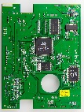

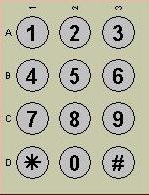
Working
If the entered password is correct, then the system opens the door by rotating the motor and displays the status of door on LCD.
Button pressed
Door is closed
Locked
This Photo by Unknown Author is licensed under CC BY-SA

Slide 9

Working
If the entered password is correct, then the system opens the door by rotating the motor and displays the status of door on LCD.
Button pressed
“Access Granted”
Door is closed
Unlocked
Correct pin
This Photo by Unknown Author is licensed under CC BY-SA

Slide 10

Working
If the entered password is correct, then the system opens the door by rotating the motor and displays the status of door on LCD.
Button released
“Door is open”
Door is opened
Unlocked
This Photo by Unknown Author is licensed under CC BY-SA

Slide 11
Working
If the password is wrong, then the door remains closed and displays “Incorrect Pin” on the LCD.
Button pressed
Door is closed
Locked
Incorrect pin
This Photo by Unknown Author is licensed under CC BY-SA

Slide 12
Working
If the password is wrong, then the door remains closed and displays “Incorrect Pin” on the LCD.
Button pressed
“Incorrect Pin”
Door is closed
Locked
Incorrect pin
This Photo by Unknown Author is licensed under CC BY-SA

Slide 13
Working
The separate unlock button directly unlocks the door by calling an interrupt.
Button pressed
Door is closed
Locked
This Photo by Unknown Author is licensed under CC BY-SA

Slide 14
Working
The separate unlock button directly unlocks the door by calling an interrupt.
Button pressed
“Access Granted”
Door is closed
Unlocked
This Photo by Unknown Author is licensed under CC BY-SA

Slide 15
Working
The separate unlock button directly unlocks the door by calling an interrupt.
Button released
“Door is Open”
Door is opened
Unlocked
This Photo by Unknown Author is licensed under CC BY-SA

Slide 16
Working
For re-locking the door, the system waits until a certain delay is over. When the delay is over as well as the door has been shut, it locks the door by rotating the motor in opposite direction.
Button released
“Door is Open”
Door is opened
Unlocked
The door will remain unlocked
as long as it is open
This Photo by Unknown Author is licensed under CC BY-SA

Slide 17
Working
When the door is shut, a push button gets pressed informing the microcontroller that the door is ready to be locked.
Button released
“Door closed”
Door closed
Unlocked
This Photo by Unknown Author is licensed under CC BY-SA

Slide 18
Working
When the door is shut, a push button gets pressed informing the microcontroller that the door is ready to be locked.
Button pressed
Door closed
Unlocked
This Photo by Unknown Author is licensed under CC BY-SA

Slide 19
Working
When the door is shut, a push button gets pressed informing the microcontroller that the door is ready to be locked.
Button pressed
“Locking the door”
Door closed
Locked
This Photo by Unknown Author is licensed under CC BY-SA

Slide 20
Simulation
We have used Keil µVision5 to prepare the code and generate the HEX file. The Proteus software has been used for the simulation of the project where we have designed the circuit.

Slide 21
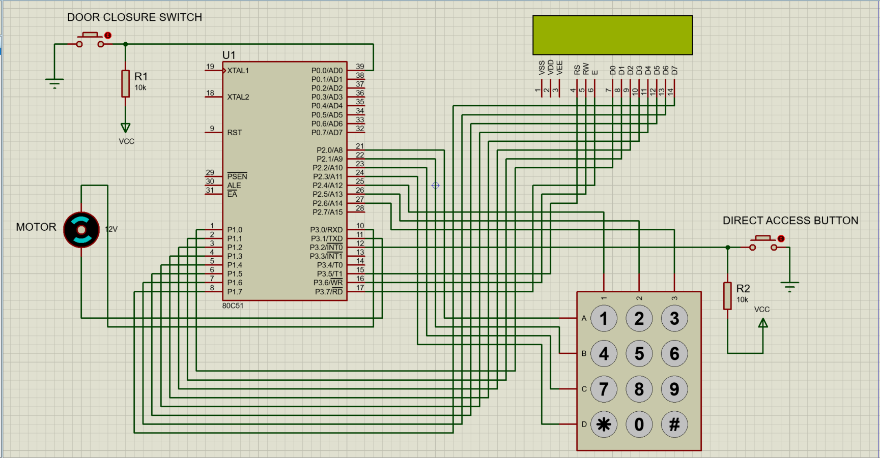
Circuit Diagram

Slide 22
Applications
- This system can be used at residential places, offices to provide quick but secure access.
- It eliminates the need to carry physical security keys.
- We can make it even more secure by
1. Decreasing the delay after which the door locks.
2. Requiring password for entry from either sides of the door.
3. Increasing the length of the pin

Slide 23
Conclusion
This project is meant to provide a security system whose access is owned only by required authorities. Using the microcontroller, entered password is checked with the stored password and based on that corresponding operation is performed. The door is then locked again.

Slide 24
Thank You!

